Slide 1
TOP 5 Best Practices in Classroom Managementin Adult Education
Based on Interview with Current Instructor and STudent

Slide 2

Interview Questions
For my research, I interviewed a current NBCC Instructor and a graduating student.

Slide 3

Instructor Questions
How long have you been teaching?
What was your motivation for being a teacher?
How did you learn about classroom management?
What techniques have you used for classroom management?
What has been most effective?
Have you noticed any changes in students since you started teaching?

Slide 4
Student Questions
What were your expectations about college learning?
Did you experience any classroom behaviours that negatively affected your learning?
Do you believe the techniques used in the classroom for classroom management were effective?
What were the most/least effective techniques used?
Did the techniques respect adult learning principles?

Slide 5

Top 5 Best Practices in Classroom Management in Adult Education
Based on my analysis of the results of these interviews, as well as additional research using course material and the internet, I came up with 5 best practices.

Slide 6

1. Establish Rules
It is important to let all students know what your classroom rules are on day one. This should be done verbally, and in writing. This ensures that they know what is expected of them, and what behavior will not be tolerated. Also, by having this, when a rule is broken by a student, you can refer back to your document which outlines the rules.

Slide 7

2. Motivate them to explore
Allow the student to pic a topic of their own and research it, as opposed to choosing the topic for them. Adults enjoy applying their personal experience and learning on their own.

Slide 8

3. Be Friendly, but not Friend
Keep the relationship with students professional. You are not their friends. If you are friends, students may not respect you as much. They may also think rules do not apply to them. Other students may also see you as playing favorites with the student friend.

Slide 9

4. Keep them busy and active in their learning
Try to always have something for them to work on. Even if you don’t have something new to teach that day, make sure you have an activity to keep them busy. Busy students will make classroom management easier.

Slide 10
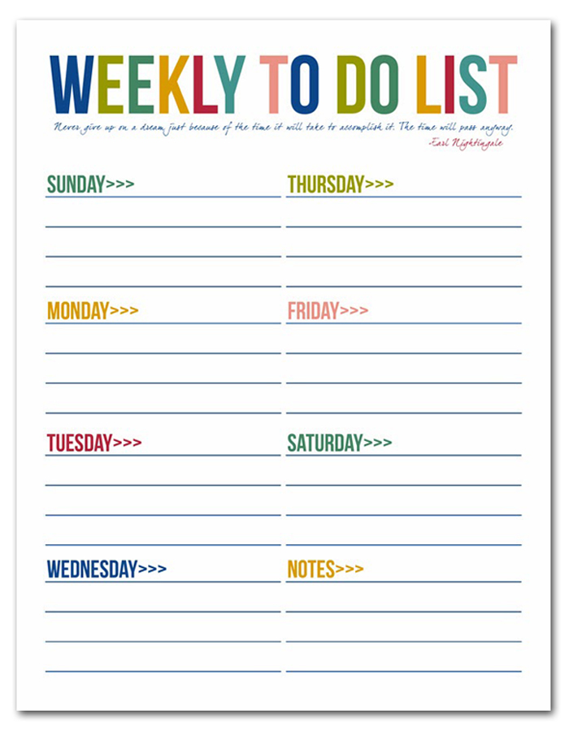
5. Be Transparent
Adult students like to know what they should be doing. Each week, provide the students with an outline of the plan for that week.

